Slide 1
Common Language Runtime Presentation
By
Ch.Maheswar Reddy

Slide 2
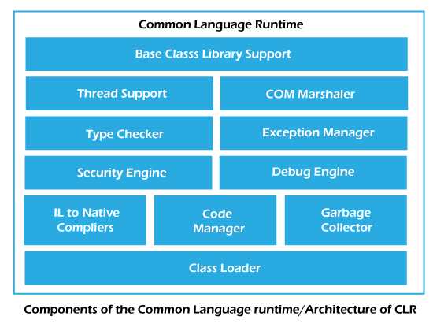

Slide 3
Base Class Library Support:
The Base Class Library (BCL) has a collection of libraries and functions.
The BCL contains multiple libraries such as Collections, I/O, XML, DataType definitions, etc. for the multiple .NET programming languages.
Thread Support:
The thread support for managing the parallel execution of multiple threads in application.
The System.Threading class is used as the base class for this.
Ex : Google Chrome which is having multiple tabs.

Slide 4
COM Marshaller:
COM Marshaller provides communication between the COM (Component Object Model) objects and the application.
Type Checker:
Type checker is used to check the type of the variables and verifies the standards of the variable by CLR.
Here, standards means size of the data type for example if we trying to assign the 10’s digit number to the int data type if doesn’t work.

Slide 5
Exception Manager:
Exception Manager handles the exception . So, the normal flow of the program is continuing or else it declares the exception to intimate the programmer what type of exception is occurs.
Security Engine:
The security Engine in the CLR handles the security permissions at various level such as code level, folder level and machine level.
This is done using the various tools that are provided by the . Net Framework such as Automated Vulnerability scanning, Firewall.

Slide 6
Debug Engine:
Debug engine is used to debug the different kind of errors and exceptions occurred in the application.
This means it finds the problem which is occurred int the program.
Ex : a = 100 , b = 100
sum =200 Correct
if sum = 300 Incorrect
JIT Compiler(IL to Native Compilers ):
The JIT Compiler in the CLR converts the Microsoft Intermediate Language (MSIL) into the machine code.

Slide 7

Code Manager:
Code manager is used to manage the code during execution.
The managed code is converted to intermediate language by a language-specific compiler.
Code Manager allocating the memory to the variables or to the objects.
Garbage Collector:
Garbage Collector has the feature of automatic memory management.
It removes the unreferred objects and releases the memory space.

Slide 8
CLR Loader:
Various modules, resources, assemblies, etc. are loaded by the CLR loader.
CLR Loader loads the modules on demand if they are actually required so that the program initialization time is faster and the resources consumed are lesser.

Slide 9
Thank you

